Slide 1

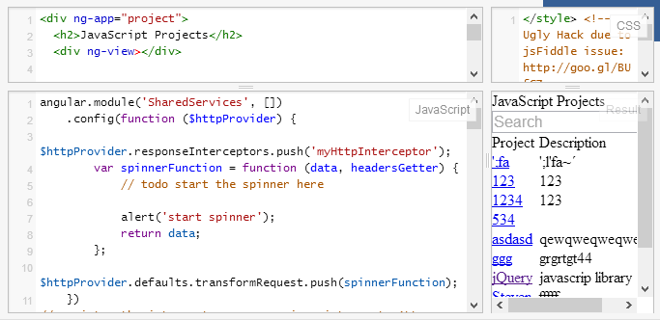


JavaScript End-to-End Apps
Course Program, Evaluation, Exams
End-to-end JavaScript Applications
Telerik Software Academy
http://academy.telerik.com

Slide 2

Table of Contents
What's Coming Next in the Academy?
The JavaScript EtE Course Program
Exams and Evaluation
Standard Criteria
Bonuses
Resources for the Course

Slide 3

JavaScript End-to-End
Coming To The Next Module

Slide 4
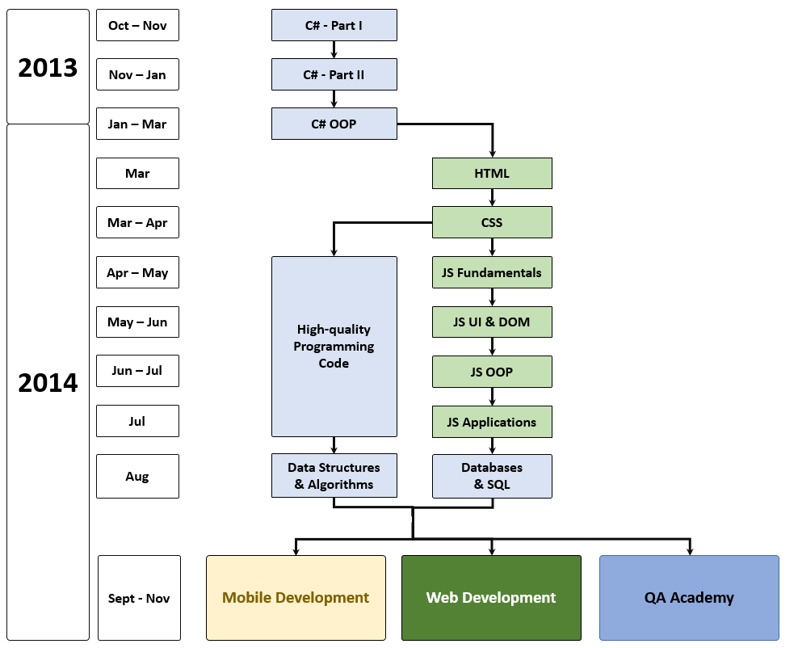
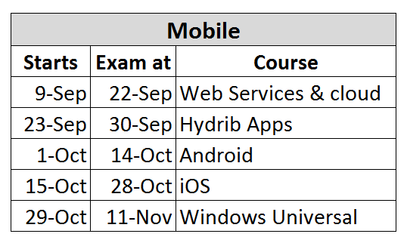
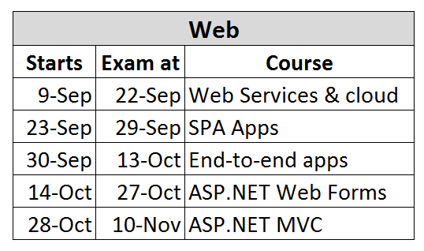
What's Coming Next?

Slide 5

JavaScript EtE – Program
What Will We Cover in the JavaScript EtE?

Slide 6


The JS EtE Course Program
Course Introduction
Introduction to Node.js
Node.JS Web Server
Advanced Node.js
NoSQL databases with Node.js
View engines
ExpressJS

Slide 7


The JS EtE Course Program
Unit testing Node.js
Tools for development
MEAN stack
App deployment in Cloud
Continuous integration
Exam preparation
Team work
Exam

Slide 8





Evaluation
Thank God There Are Bonuses!

Slide 9

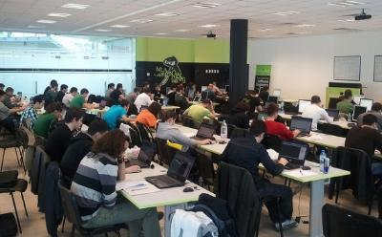
JavaScript EtE – Evaluation
Evaluation components
Practical exam – 45%
Exam evaluation – 10%
8 exam peer reviews
Homework – 10%
Homework evaluation – 5%
3 peer reviews per homework
Teamwork – 20%
Attendance in class – 10%
Bonuses
Forums activity – bonus up to 5%

Slide 10


Pass / Excellence / Fail Criteria
Criteria for pass / pass with excellence / fail
Pass with excellence
Very high exam results
or
High total results
Pass
Average total results
Fail
Low total results or low exam results

Slide 11
Homework Peer Reviews
Everyone will get feedback for their homework
Everyone will give feedback for few random homework submissions
Students submit homework anonymously
Please exclude your name from the submissions!
For each homework submitted
Students evaluate 3 random homeworks
From the same topic, after the deadline
Give written feedback, at least 200 characters
Low-quality feedback → report for punishment

Slide 12
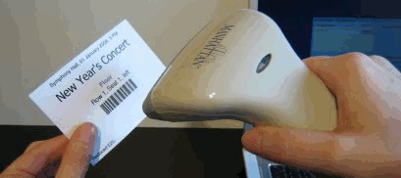
Check Your Presence
From now on you should check your presence on the barcode reader 3 times a day:
In the morning when lectures begin (~10:30)
After lunch break (~13:30)

Slide 13



Use the Same Email!
Please use the same email address in:
http://telerikacademy.com
http://bgcoder.com
http://forums.academy.telerik.com
Otherwise your score could be incorrectly calculated!

Slide 14








Resources
What We Need in Addition to this Course Content?

Slide 15

Course Web Site & Forums
Register for the "Telerik Academy Forums":
Discuss the course exercises with your colleagues
Find solutions for the exercises
Share source code / discuss ideas
The JS EtE official web site:
http://forums.academy.telerik.com/web-development/end-to-end-javascript-applications
academy.telerik.com/student-courses/software-technologies/javascript-end-to-end-apps

Slide 16
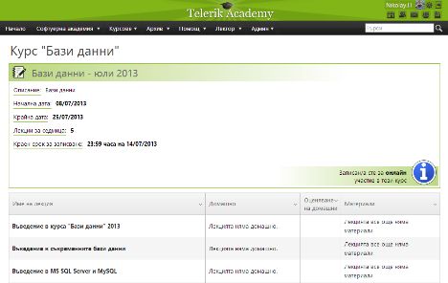
Telerik Integrated Learning System (TILS)
The Telerik Integrated Learning System (TILS)
www.telerikacademy.com
Important resource for all students
Homework submissions
Homework peer reviews
Presence cards with barcode
Reports about your results
telerikacademy.com/Courses/Courses/Details/192

Slide 17


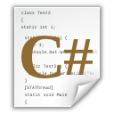


JavaScript EtE
http://academy.telerik.com

Slide 18




Free Trainings @ Telerik Academy
C# Programming @ Telerik Academy
csharpfundamentals.telerik.com
Telerik Software Academy
academy.telerik.com
Telerik Academy @ Facebook
facebook.com/TelerikAcademy
Telerik Software Academy Forums
forums.academy.telerik.com

